Slide 1
Building a Wellbeing Champions Community
Best Practices
2026

Slide 2


The Power of Champions
Every organization has natural wellbeing champions– even if you don’t know who they are yet
They’re passionate about health and wellbeing
Identify and empower them
Give them the tools and training they need to make an impact
They can help you listen, connect, and amplify the employee voice
People TRUST Information From People They Know

Slide 3
The Role of a Wellbeing Champion
×
×
×
  Raise awareness of wellbeing resources and initiatives
  Actively listen to colleagues and understand their needs
  Guide colleagues to appropriate wellbeing resources
  Help reduce stigma around health and wellbeing, including mental health
  Build trust and maintain appropriate confidentiality
  Collaborate with other Wellbeing Champions and share best practices
Their role is not to:
× Counsel colleagues
× Diagnose conditions
× Go beyond personal or professional boundaries

Slide 4

What’s in it For Them?
  Help shape the organization’s future culture and benefits strategy
  Connect with like-minded colleagues across
  Learn practical skills to recognize and support colleagues who may be struggling
  Build your understanding of common health conditions and how to support those affected
  Develop valuable skills, including active listening
  Receive monetary or other tangible incentives

Slide 5
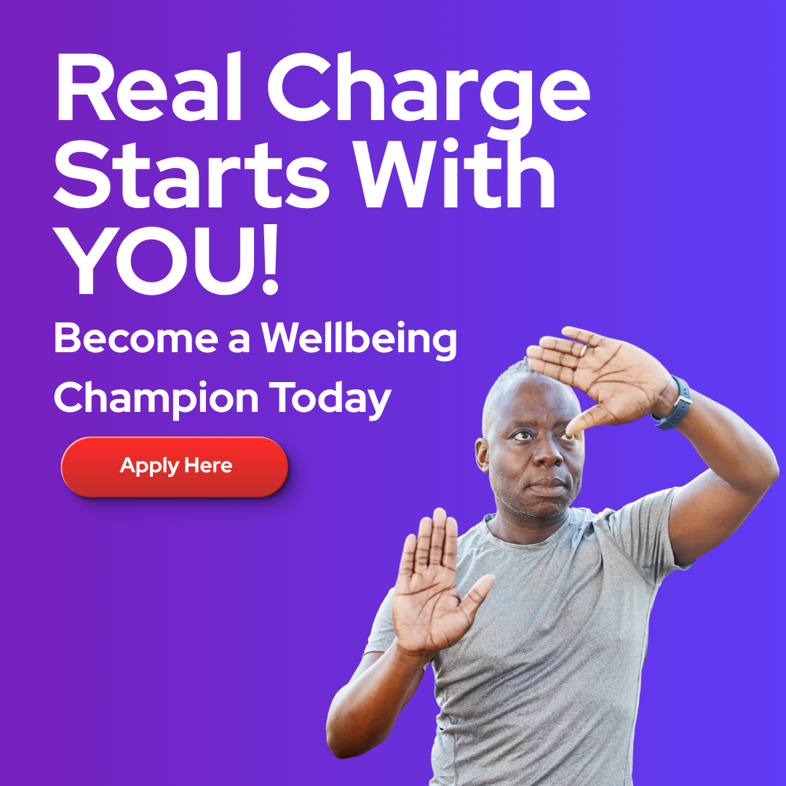
Expectations and Commitment
  Role Duration: Typically 6 or 12 months
  Time Commitment: Set number of hours per week or month
  Training: Initial training plus ongoing learning and support
  Confidentiality: Understand and uphold confidentiality expectations
  At the End of the Term: Choose whether to continue as a Wellbeing Champion

Slide 6
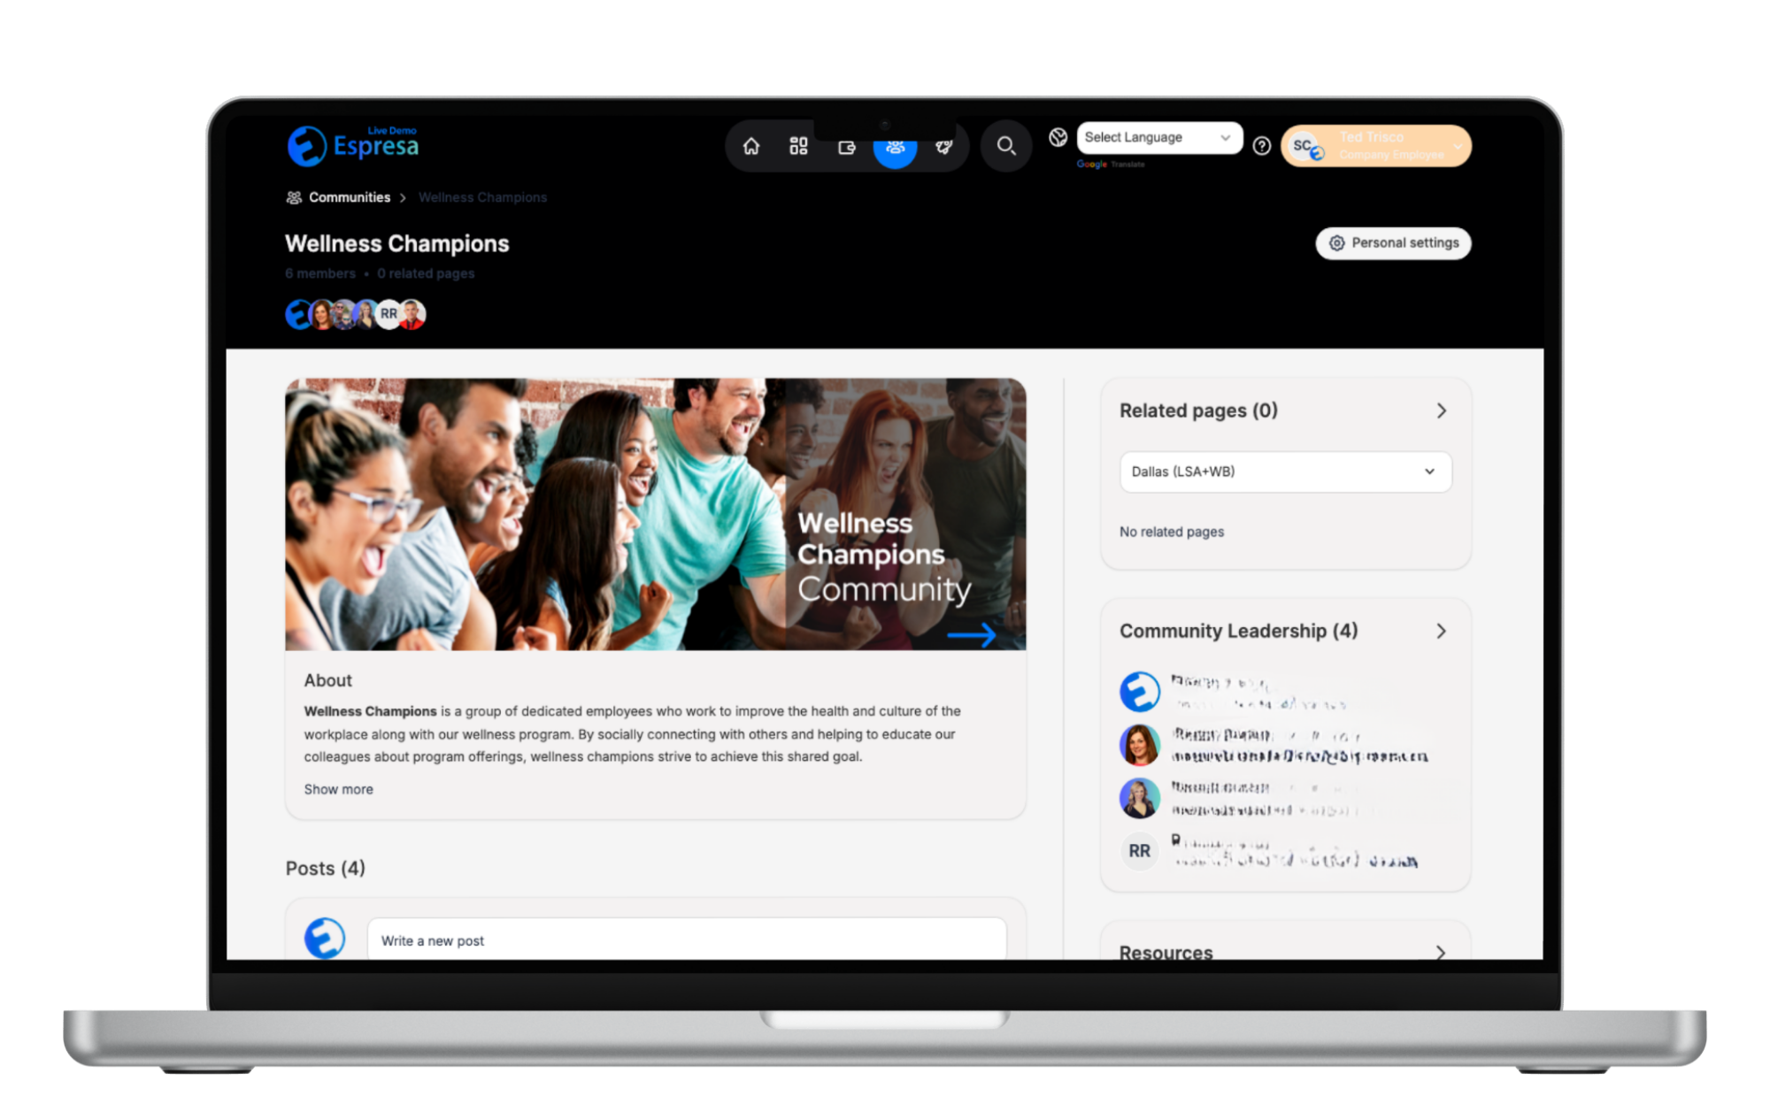
Recruitment Considerations
Become a Wellbeing Champion
  Recruitment Approach: Nominations, volunteers, or both?
  Selection Process: Open to all or application-based?
  Number of Champions: How many are needed across the organization?
If you are interested in becoming a Wellbeing Champion, please fill out this short form:
Your name:
Your current role at [Company]:
What areas of Wellbeing are you most passionate about?
What skills, experiences, or ideas would you bring to the Champions Network?

Slide 7

Annual Onboarding
  Team kick-off and introductions
  Executive sponsor and leadership support
  Program mission and strategy
  Goals and priorities for the year
  Training and development
  Key contacts and ongoing support

Slide 8
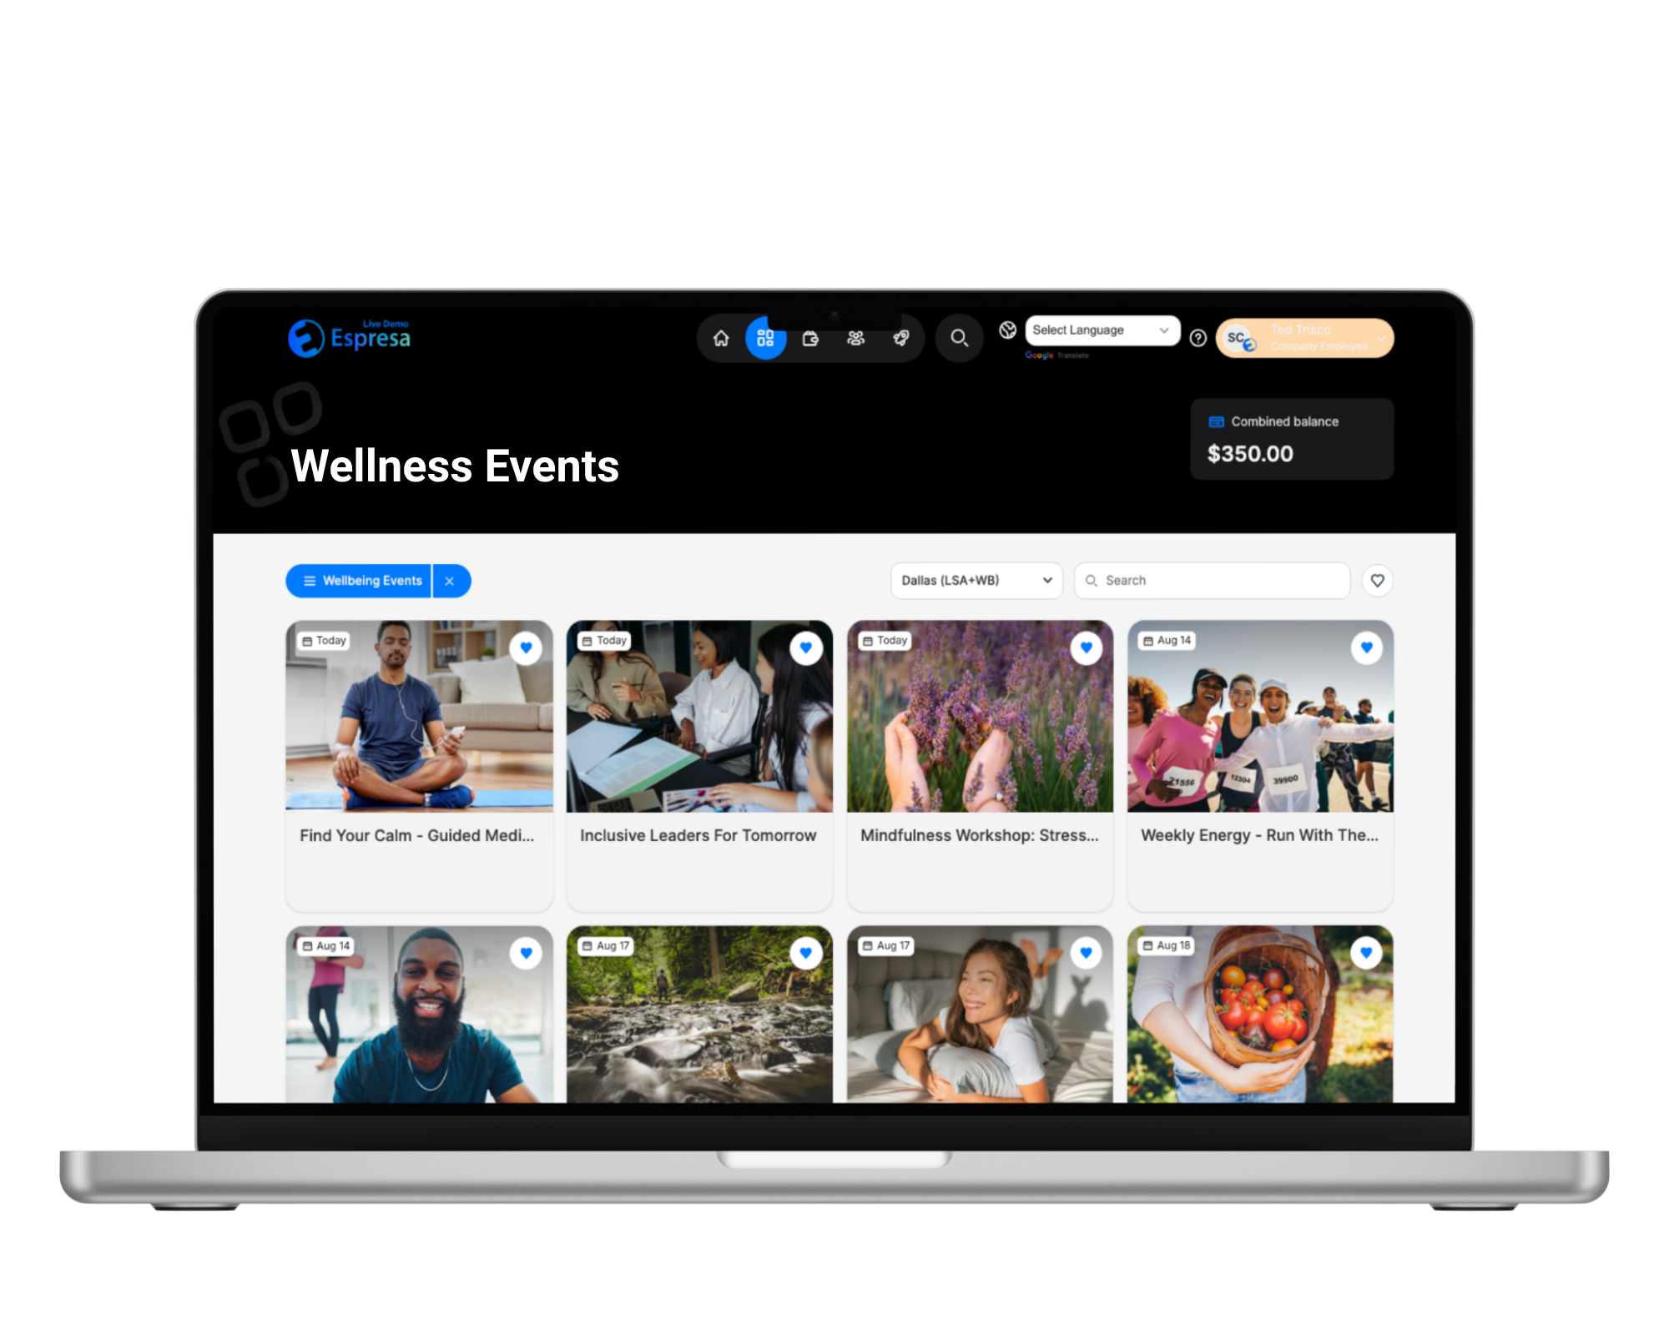
Keep it Going
  Meet regularly
  Start small and build momentum
  Play to people’s strengths
  Celebrate and share successes
  Gather feedback
  Measure and communicate impact

Slide 9
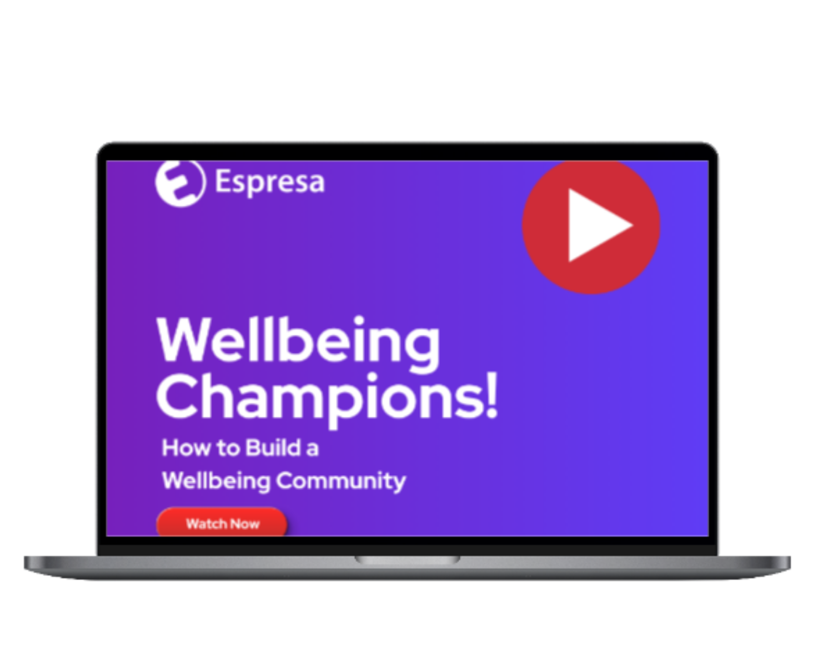
Learn More About Wellbeing Champions
Watch the “How to Build a Wellbeing Champions Community” Video →

